Slide 1
Abalone Age prediction
USING MACHINE LEARNING

Slide 2
Abalone Age prediction Using Machine Learning
Presented by:
Pusuluri Ajith
Shaik Mabu Subhani
Shaik Mannepalli Karishma
Shaik Mohammad Riyaz
Guide By :
Department of Computer Science & Engineering

Slide 3
Problem Statement
Determining the age of an abalone traditionally requires cutting the shell and counting the growth rings under a microscope, which is time-consuming, destructive, and impractical for large-scale analysis. There is a need for a non-invasive and automated method to estimate abalone age accurately. This project aims to develop a machine learning-based prediction model that estimates the age of abalone using easily measurable physical features.

Slide 4
Abstraction
The project focuses on predicting the age of abalone (a type of sea snail) using machine learning algorithms. Traditionally, age is determined by counting shell rings, which is time-consuming and invasive. By applying ML models, the age can be predicted accurately using measurable features like length, diameter, height, weight, etc. This project aims to provide a non-destructive, efficient, and automated method for age estimation.

Slide 5
Objectives
To develop a machine learning model for non-invasive prediction of abalone age using physical features.
To analyze and preprocess the Abalone dataset for better prediction accuracy.
To evaluate and compare different regression models to identify the most efficient prediction method.

Slide 6
Introduction
Abalone are marine mollusks valuable for research and commercial purposes.
Age estimation helps in sustainable fishery management.
The dataset used: UCI Machine Learning Repository – Abalone Dataset.
Predicting age (number of rings + 1.5 years) is a regression problem.
Features include: Sex, Length, Diameter, Height, Whole weight, Shucked weight, Viscera weight, Shell weight.

Slide 7
Existing Model
Traditional method: Counting shell rings under a microscope.
Drawbacks:
Time-consuming and costly.
Requires killing the abalone.
Prone to human error.
Earlier computational attempts used simple Linear Regression or ANNs with limited accuracy.

Slide 8
Proposed Model
Proposed a Machine Learning-based predictive model for estimating abalone age.
Utilized feature scaling, encoding, and regression algorithms.
Explored multiple ML techniques:
Random Forest Regressor
XGBoost Regressor
Linear Regression
Selected the best-performing model based on evaluation metrics.
Implemented the model using Python (Scikit-Learn, Pandas, NumPy, Matplotlib).

Slide 9
Software Requirements
Python 3.x
Libraries: NumPy, Pandas, Scikit-learn, Matplotlib
Jupyter Notebook / VS Code
Streamlit (for UI, optional)
Hardware Requirements
Processor: Intel i3 or above
RAM: 4GB minimum
Storage: 500GB HDD or SSD
Internet connection (for datasets)

Slide 10
Project Flow
Flow Diagram:
Data Collection → Data Preprocessing → Feature Selection →
Model Building → Model Evaluation → Result Visualization → Prediction Output

Slide 11
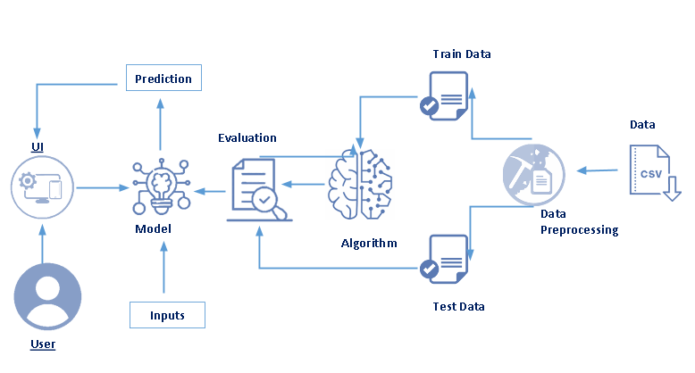
System Architecture:

Slide 12
Model Used
Algorithm: Random Forest Regressor
Reason for Selection:
Handles non-linear relationships effectively
Reduces overfitting
Provides high accuracy and interpretability
Performance Metrics:
R² Score: ~0.54 (approx., typical for Abalone dataset)
RMSE: Lower compared to other models
Tools & Libraries:
Python, Jupyter Notebook
Scikit-learn, Pandas, Matplotlib

Slide 13
Advantages & Disadvantages
Advantages:
Non-destructive age prediction
Time-efficient and cost-effective
Scalable and automated
Improved accuracy with ensemble methods
Disadvantages:
Requires large dataset for better accuracy
May not generalize well for unseen environments
Data imbalance between age groups can affect predictions

Slide 14
Conclusion
The machine learning model successfully predicts abalone age with reasonable accuracy.
Random Forest performed best among tested models.
The system provides a fast, reliable, and non-invasive method of estimating age.
Future work:
Use deep learning for higher accuracy
Integrate the model into a web or mobile app for practical use
Include more biological features for better predictions

Slide 15
